Slide 1
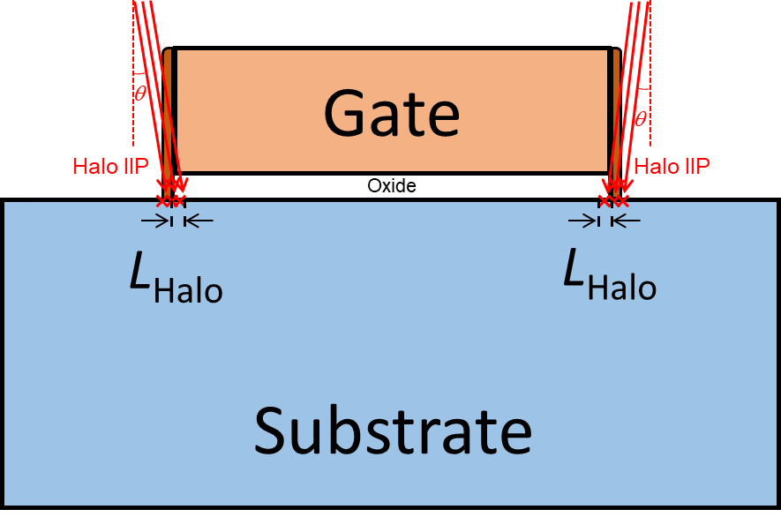
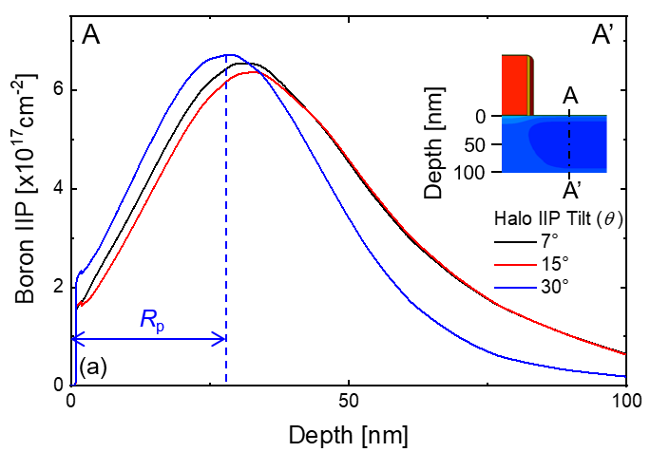
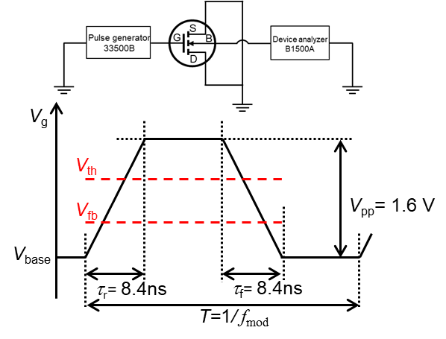
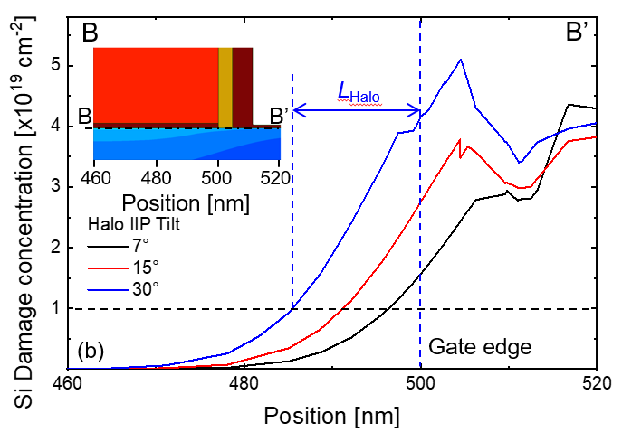
Non-uniform Interface Trap Modeling by Halo Ion-Implantation
Yoo Bin Song¹, Sang Hyo Ahn¹, Min Jae Kim¹, Min Woo Ryu¹ and Kyung Rok Kim^{1*}
¹Department of Electrical Engineering, UNIST, Republic of Korea
The Halo Ion-Implantation(Halo IIP) process is widely used as a method to prevent short channel effects (SCEs) in Nano-scale devices. However, the halo process causes damage to the gate dielectric by injection angle and energy, which causes an non-uniform N_{it} distribution [1]. This non-uniform N_{it} distribution affects the noise characteristics of the device, and it is important to accurately predict the noise characteristics because as the gate area is scaled down, caused problems related to power dissipation, speed, and linearity during analog and digital circuit operation [2]. Therefore, in this study, the distribution of N_{it} generated by the tilt Halo IIP process is modeled and verified based on short channel devices (28-nm CMOS) measurement.
Modeling
Measurement
G
D
N_{it,Halo}
N_{it,Halo}
S
B
$$N_{it}= \frac{N_{it,center} \left(L_{G}− 2L_{Halo}\right)+2N_{it,Halo}L_{Halo}}{L_{G}}$$
$V_{TH(x)}=V_{FB}+2ψ_{B}+\frac{Q_{D}}{C_{ox}}−\frac{Q_{it(x)}}{C_{ox}}$
$$L_{Halo}+L_{Spacer}=R_{p}\tan\left(πθ/{180}°\right)$$
The Halo Ion-implantation process generates damage on the oxide interface, causing non-uniform N_{it} density and affecting V_{TH} and S_{ID}.
The damaged area of the gate dielectric layer by the Halo IIP process can be specified by an equation, and is determined in consideration of the IIP angle(θ) and the Projected range (R_{p}).
Assuming that the distribution of N_{it} is uniform, when L_{G} = 30 nm, there is a 53% difference from the S_{ID} obtained from measurement.
This research shows that the distribution of interface traps generated during the Halo IIP process can be non-uniform through experimental results based on 28-nm CMOS Foundry devices. And we confirm that the non-uniform N_{it} distribution can affect noise because the ratio of N_{it,Halo} regions increases as the gate length is scaled down. In other words, assuming that the distribution of N_{it} is uniform, there is a difference of 53% from the measurement, and in the case of Nano-Scale devices, noise characteristics can be accurately evaluated only when N_{it} is considered non-uniform.
Acknowledgments This work was supported by Samsung Electronics Co., Ltd (2.220863.01).
The chip fabrication and EDA tool were supported by the IC Design Education Center (IDEC), Korea.
Reference [1] Y. –F. Liu et. al., IEEE ICSSICT (2012), [2] P. Kushwaha et. al., IEEE EDL (2019)

